Slide 1





Memory Mood Mapped
Figma: https://www.figma.com/file/OUVyk3VkTwu6gNnoBKqti7/Mood-Memory-Mapped-Figma-Prototype?type=design&node-id=0-1&mode=design&t=eyBtgAeLSYti8uCl-0

Slide 2
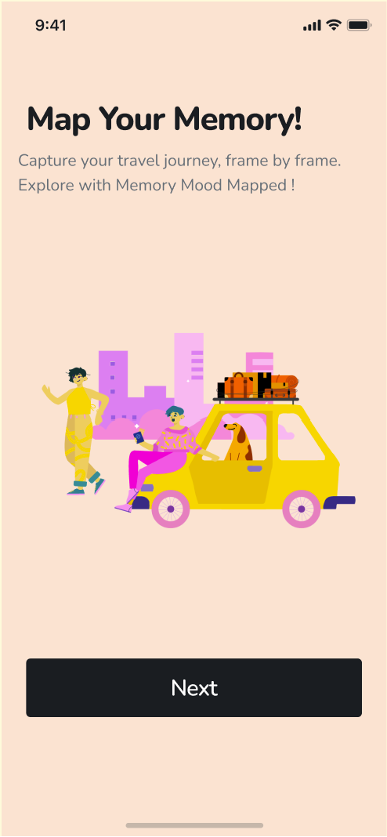
Screen 1: Welcome Page

Slide 3
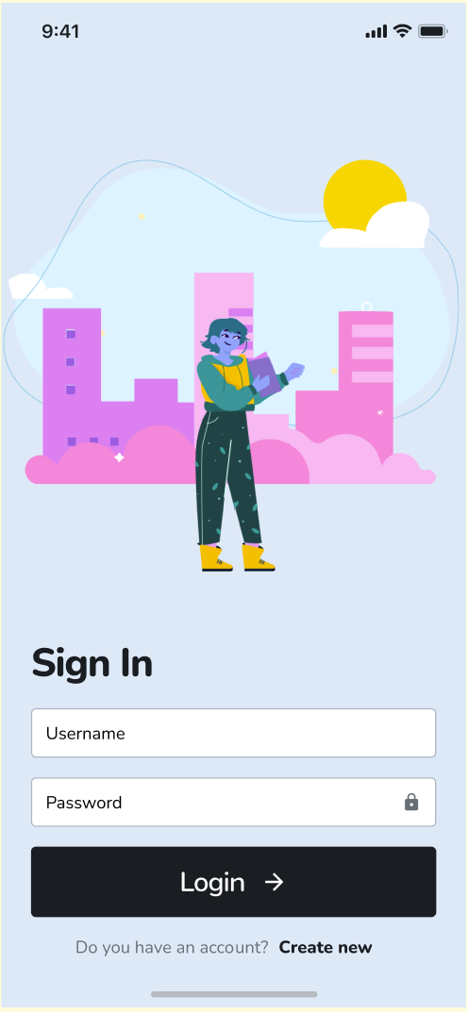
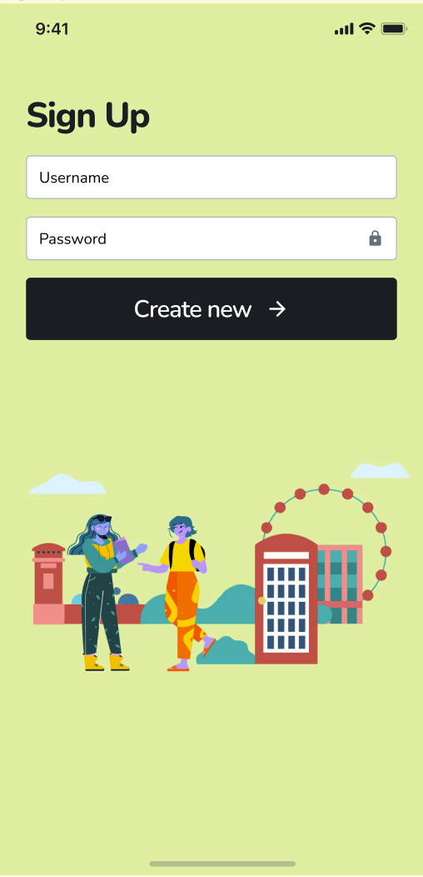
Screen 2: Sign-In Page and Sign-Up Page

Slide 4
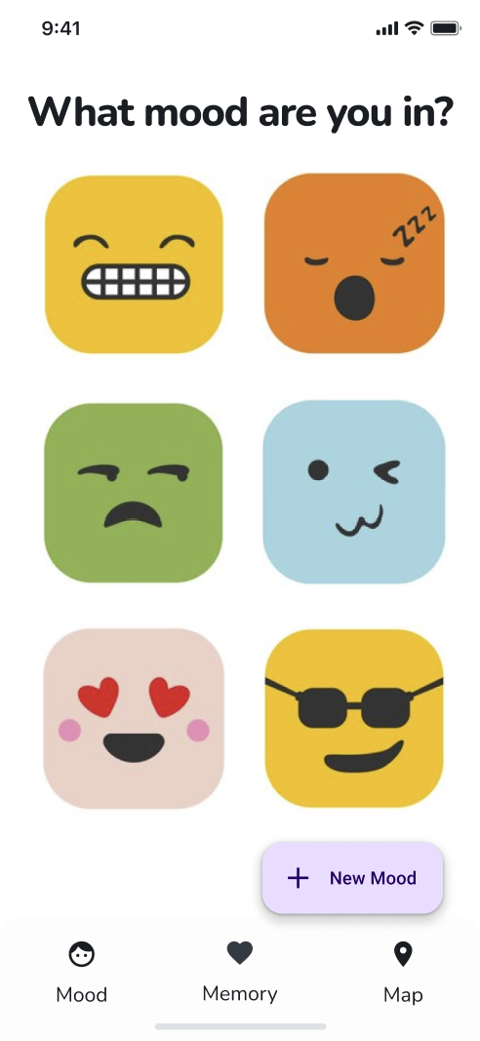
Screen 3: Mood (Home page)
- users can click the mood emoticons and insert their journal specific to the mood they were/are feeling.
- users can also add new mood emoticons where users can upload mood photos. (camera)

Slide 5
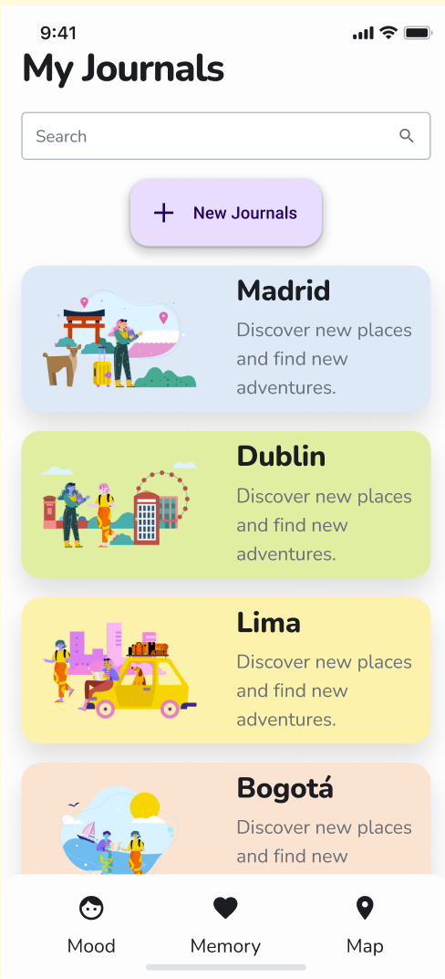
Screen 4: My Journals (after clicking emoticons)

Slide 6
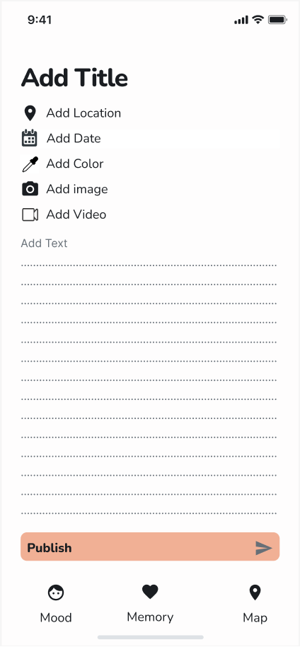
Screen 5: Memory (edit journal view)

Slide 7
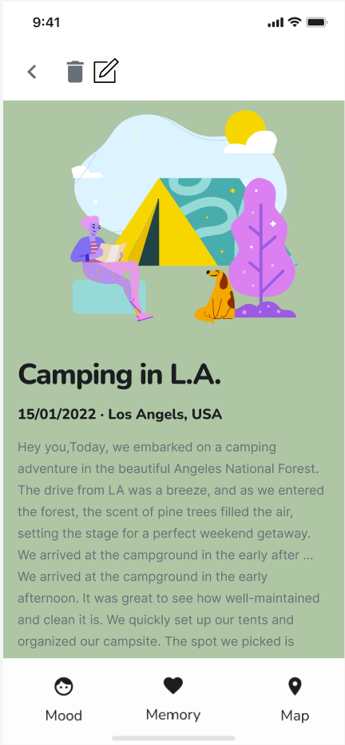
Screen 6: Memory view (viewing the journal)
- user can delete journal
- user can edit journal

Slide 8
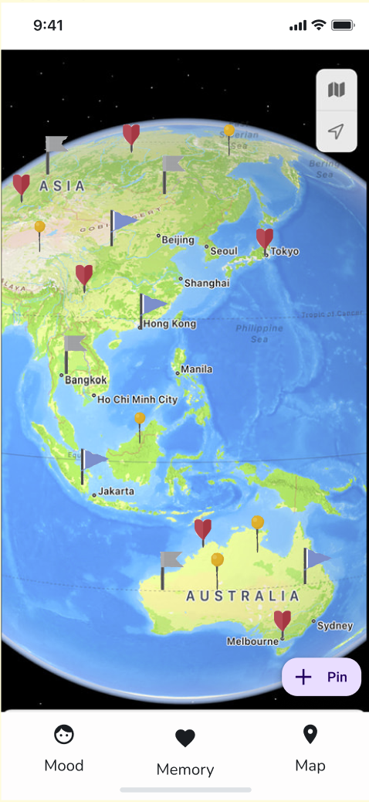
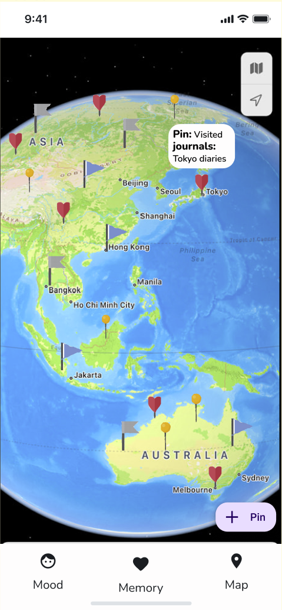
Screen 7: Map and Pin Pop-up
- When user hovers/clicks the pin on the map they can see what pin category it belongs to and what journals it contains of any (pop-up screen).

Slide 9
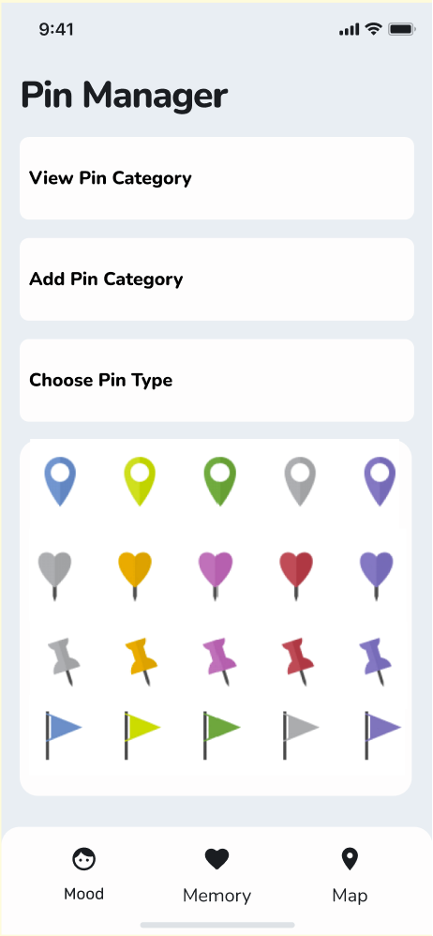
Screen 8: Pin Manager (Add Map pins)
- user can add different kinds of pins (add pin category)
- view all pin categories they have created and delete pin categories they don’t want
- choose the icon for the pin
- places visited (default pin category):
this pin is created by default when user adds location to their journal.

Slide 10
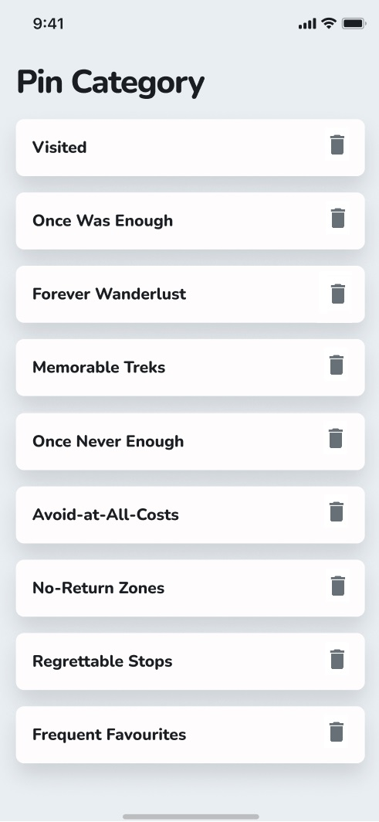
Screen 9: View Pin Category
- view pin category added to the list
- delete pin category

